Slide 1
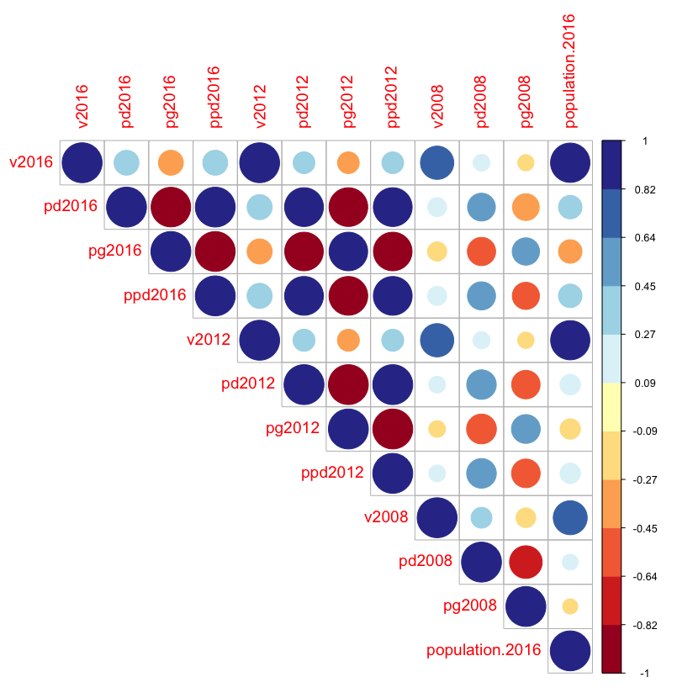





Correlation
8
Poverty estimators are highly correlated with crime rate.
6
Population demography is significantly correlated with number of votes.
9
Employment indicators are highly correlated with the educational attainments.

